Slide 1
Harvesting Rainwater
And Planting A Rain Garden
Ira Johnson, MLA
April 20, 2019

Slide 2
Presented by

Slide 3
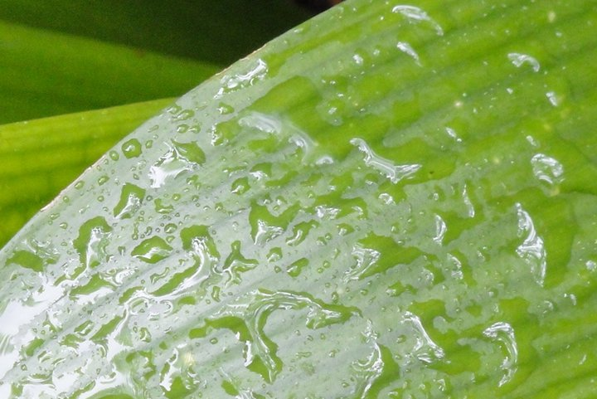
Why harvest rainwater?
Reduce use of potable water
Improve and help establish planting areas
Improve drainage on walkways and paving areas
Reduce non-point source pollution in waterways
Help improve soil conditions
Create and help sustain wildlife habitat
Notes:
Some Primary Reasons For Doing So: Are using less potable water, Improving drainage on paving, To help improve soil, And to create wildlife habitat

Slide 4
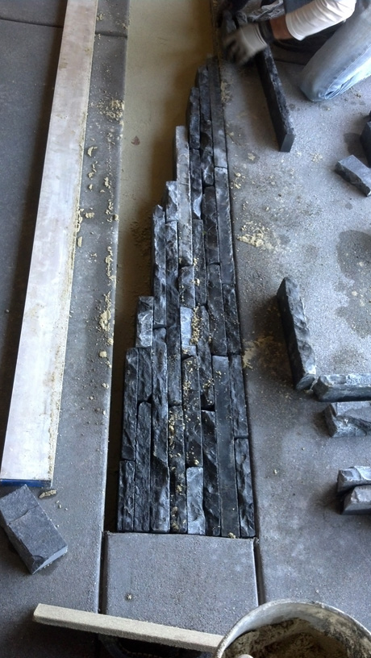
Capturing Rainwater
Use surface areas to capture
rainwater:
Rooftop Gutters
Paving Areas
Walkways
Lawn Areas
Planting Areas
Lean-tos
Notes:
In order to use rain water, you have to capture it. Stone, brick, or pavers on sand are very effective as “hidden” reservoirs

Slide 5
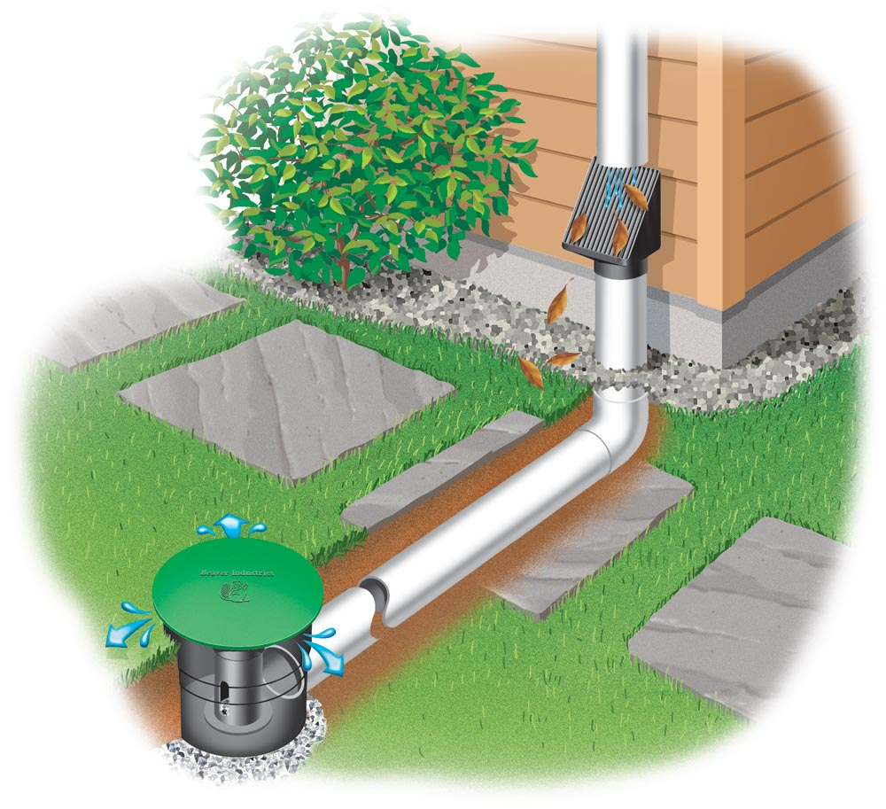
Divert rainwater to where it is needed
Directly to planting areas, including lawns
To basins and ponds
To storage containers for later use
Notes:
Pop-up emitters are useful for slowing the flow at the end of a line, and giving a more finished look

Slide 6
Examples of diversion
Notes:
Inexpensive concrete channels move water away from home foundations: “Concrete Gutters”

Slide 7
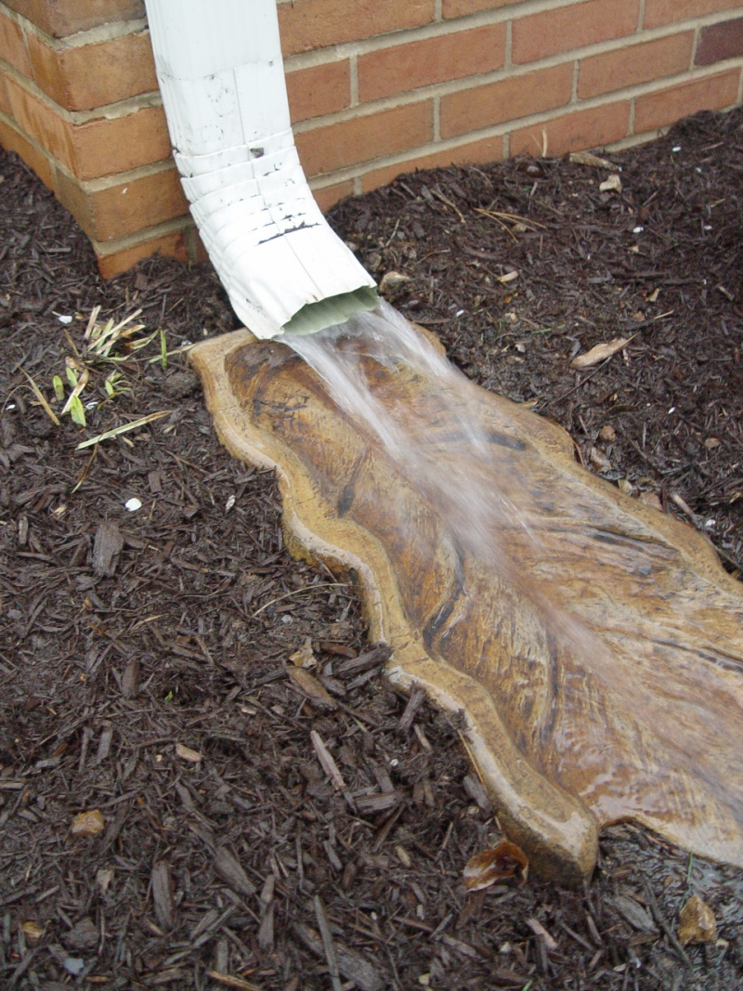
Notes:
Some come in more decorative option

Slide 8
Notes:
PVC tubing leading directly to a lawn or planting area for infiltration

Slide 9
For small amounts of storage
Consider Rain Barrels!
For more information, and to apply for rebates, go to:
BAWSCA.org
Notes:
Good for keeping pots and planters watered. Go to the Bay Area Water Supply and Conservation Agency (BAWSCA) website for more information

Slide 10
Overflow is important, and also securing the storage containers
Notes:
Barrels come in many sizes and colors. These are not secure…

Slide 11
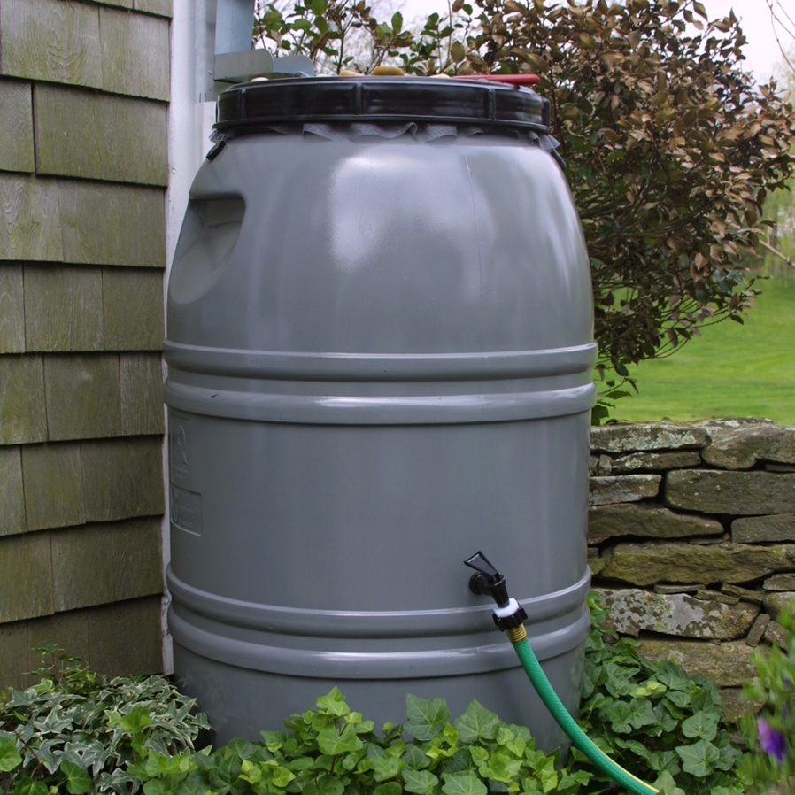

Slide 12
Other storage options are tanks
Notes:
Tanks need level ground and firm surfaces to sit on

Slide 13
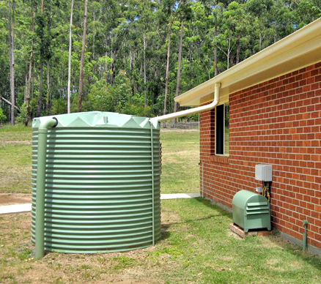

Slide 14
More tank options
Notes:
Tanks come in all shapes and sizes, and many are low profile in their shape

Slide 15
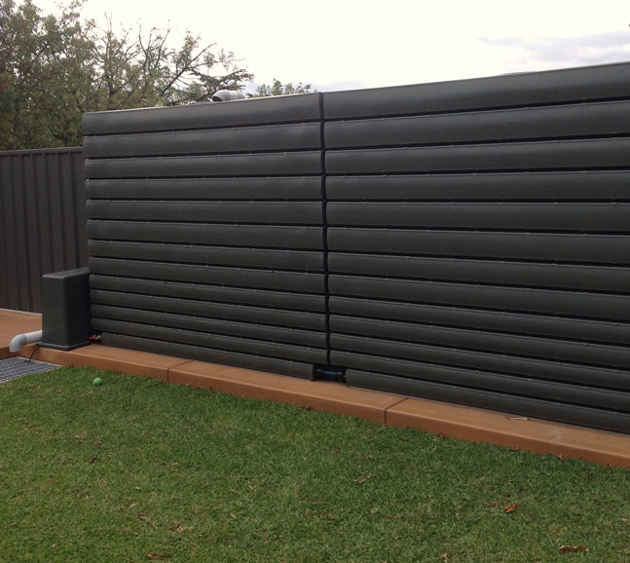
Notes:
Some tanks are designed to double as walls, and some are thin enough to fit between fences

Slide 16
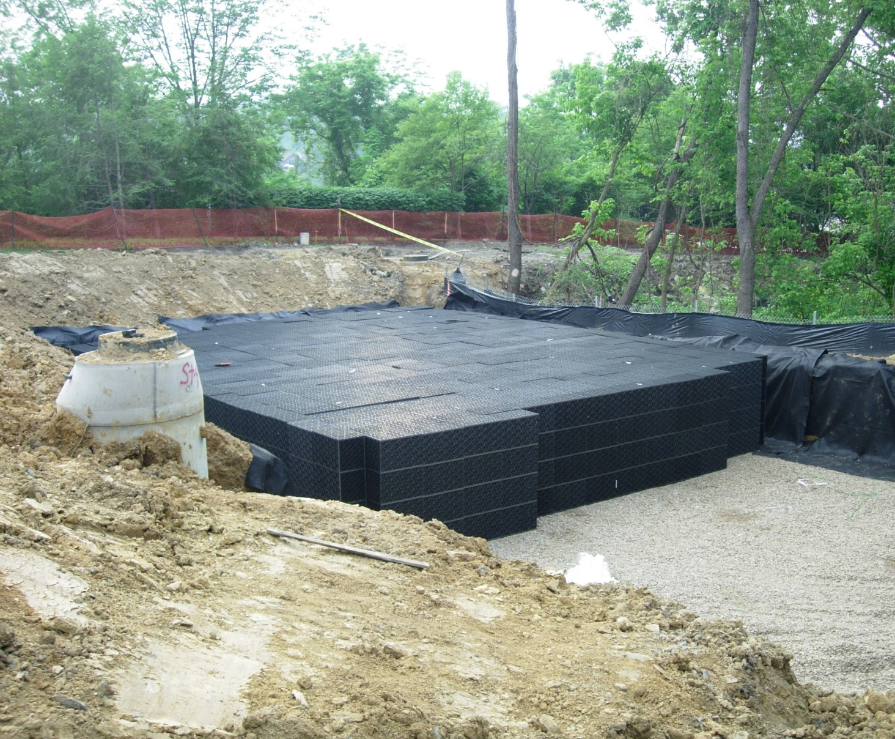
Notes:
Underground tanks require outflow lines that gravity feeds end points, or pumps

Slide 17
Design solutions
Notes:
The following slides illustrate various techniques I use in my landscape design practice to divert, slow, and utilize rainwater

Slide 18
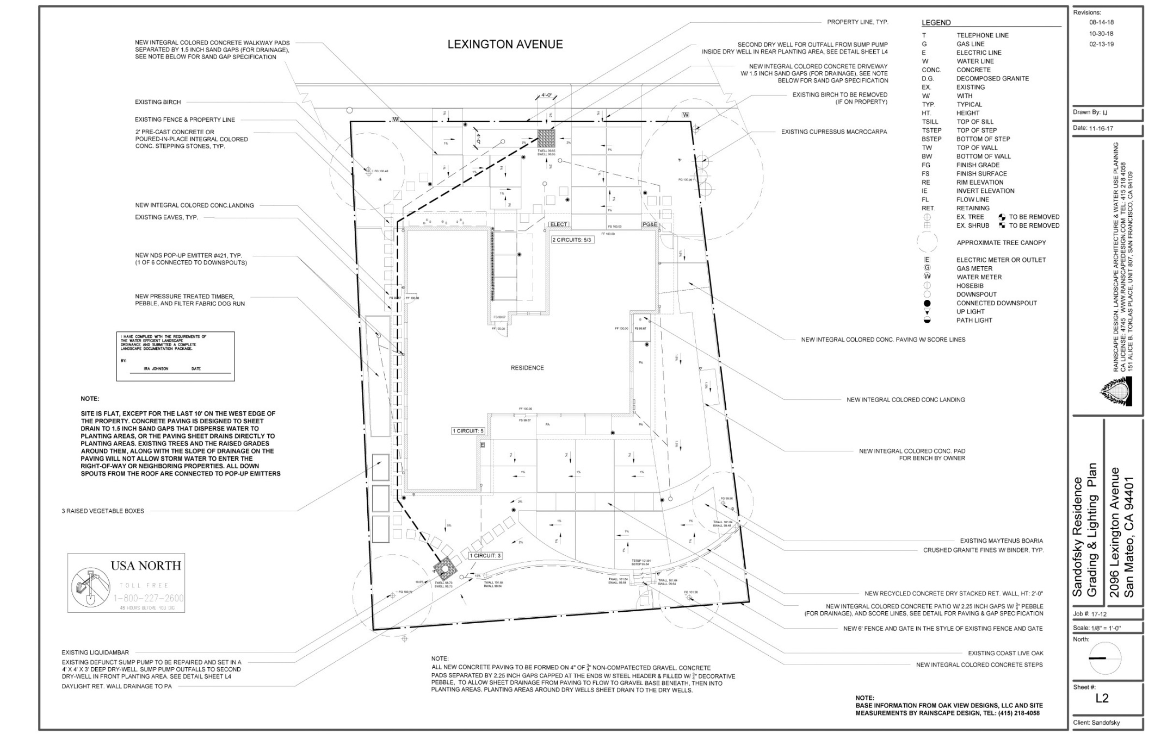
Notes:
This is a residential Grading & Drainage Plan

Slide 19
Notes:
The paving at this residence is designed to slow runoff and infiltrate it into the sub-straight, and ultimately to Dry Wells

Slide 20
Some built examples
Notes:
No drains in the paving help create a beautiful aesthetic experience

Slide 21
Notes:
Only the steps are mortared together, all other bricks sit on sand

Slide 22
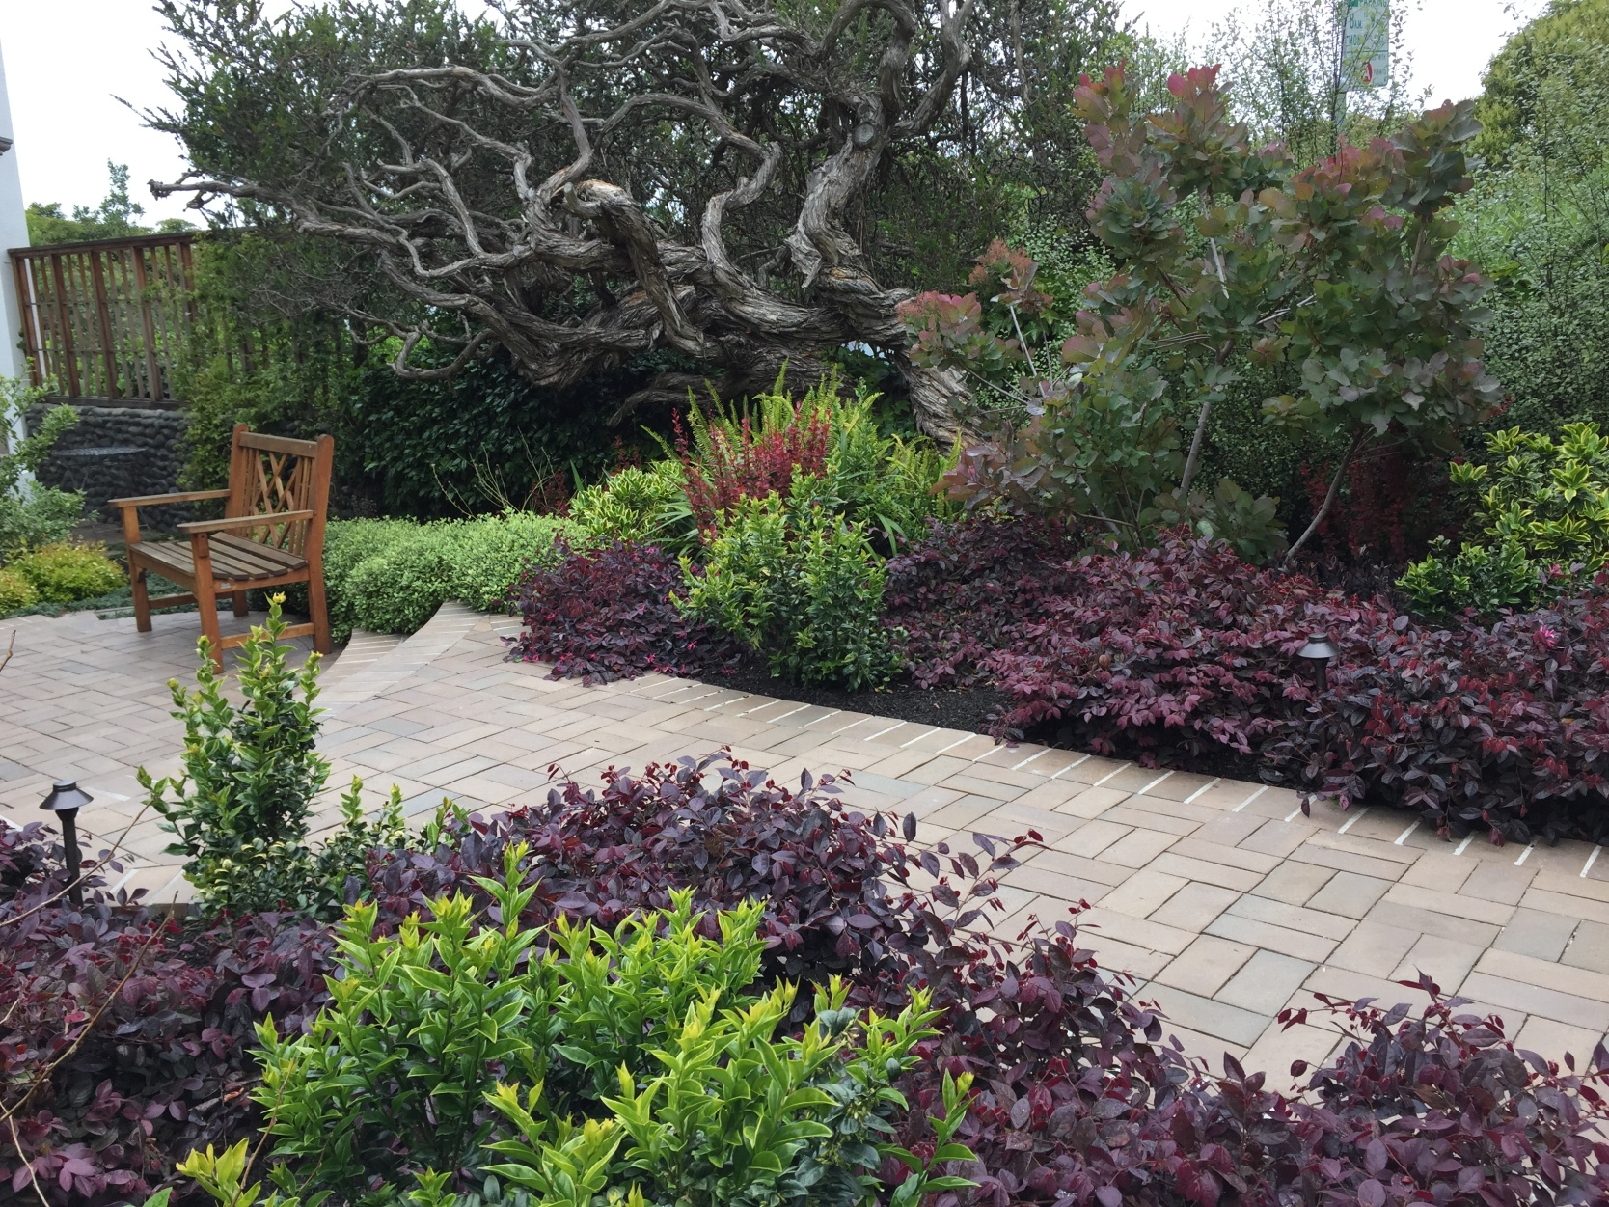
Notes:
All the rainwater collected by this walk and sunken patio benefits the surrounding garden

Slide 23
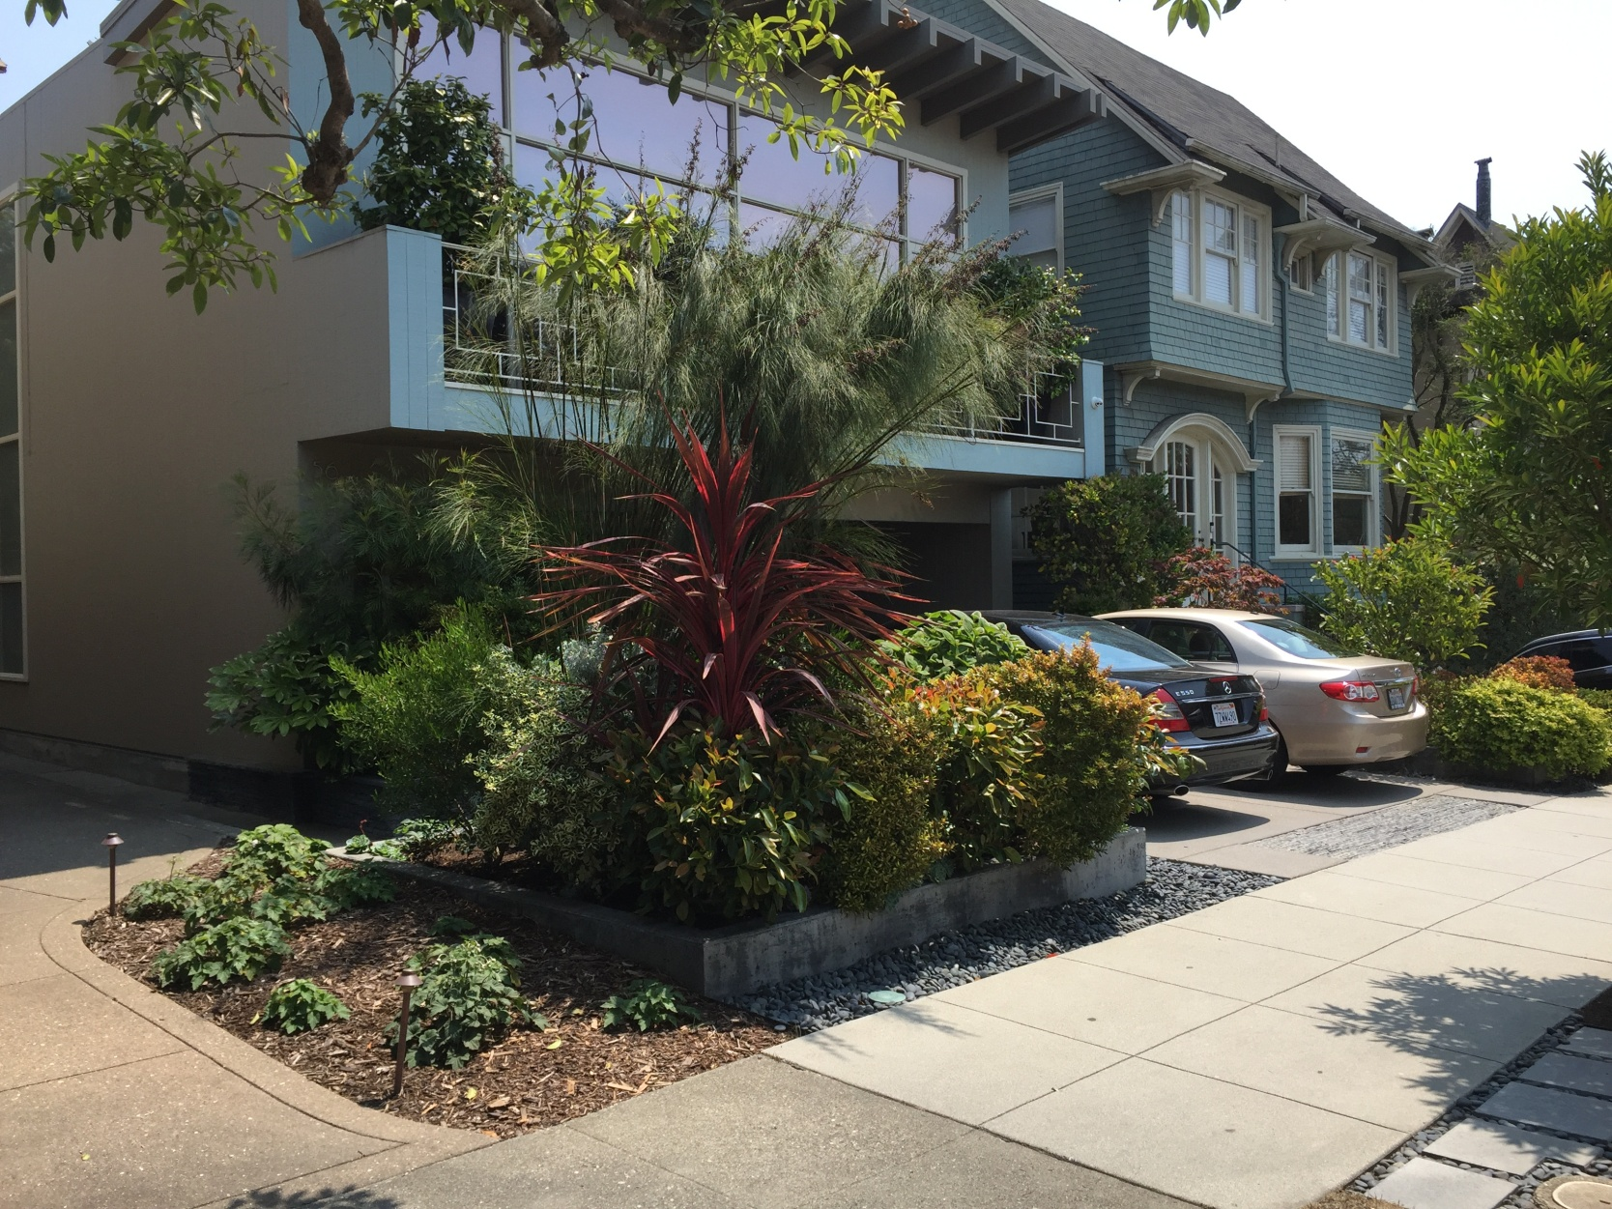
Notes:
No rainwater from this driveway reaches the public sidewalk, a San Francisco requirement

Slide 24
For more information on urban design solutions download San Francisco’s ‘Rainwater Harvesting Manual’ from docs on sfwater.org
Notes:
Stone on sand bands remove storm water runoff from walkway

Slide 25
If you have the space, there are other ways to harvest rain
Notes:
This solution saved my client in Atherton about 80K. Atherton and many other municipalities require keeping storm water on site

Slide 26
Detention Ponds
Notes:
All drainage from this 1 acre site is detained and infiltrated here

Slide 27
Earthworks
Notes:
Everything you want to know, and more, on how to build earthworks to harvest rain

Slide 28
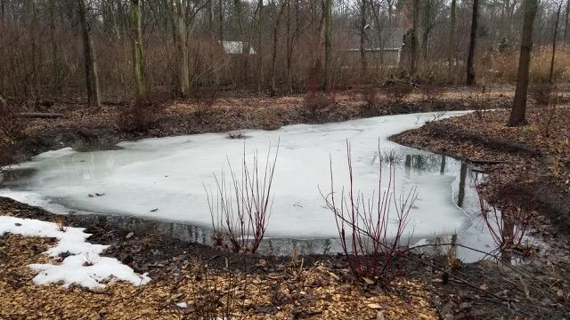
Notes:
Pond freezing over. About 8’ deep and 30’ wide. Check codes for required fencing protection

Slide 29
Eight Principles
Notes:
Eight Principles

Slide 30
Notes:
Analysis: Begin with long and thoughtful observation. Then start at the top!

Slide 31
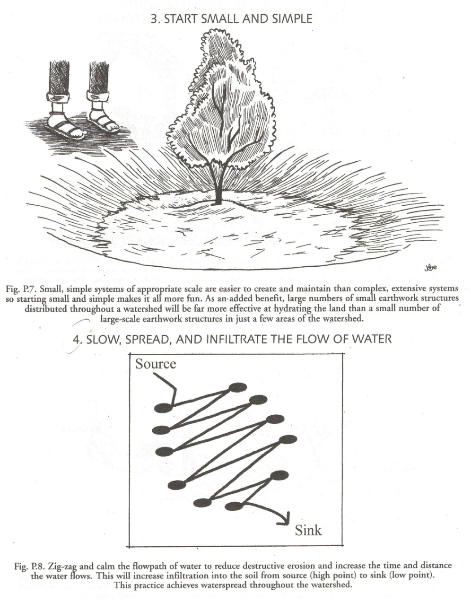
Notes:
Start small and simple & Slow, spread, and infiltrate the flow of water

Slide 32
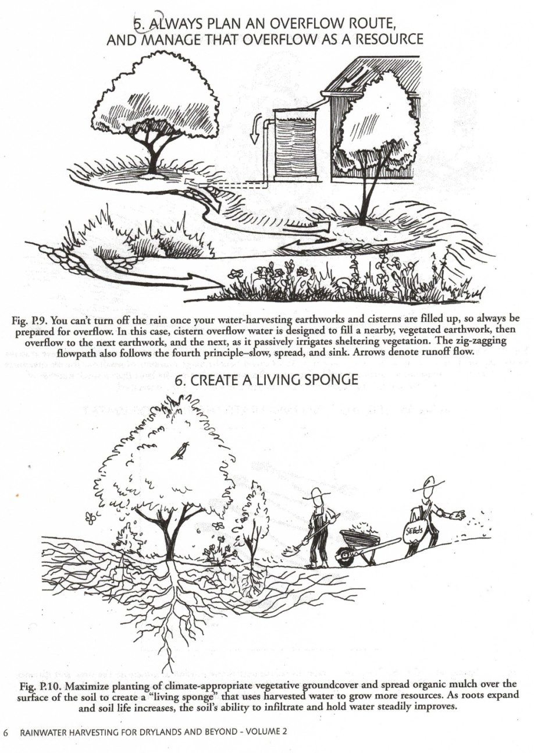
Notes:
Always plan for an overflow and use that water as a resource, if possible. And create a living sponge by improving soil conditions

Slide 33
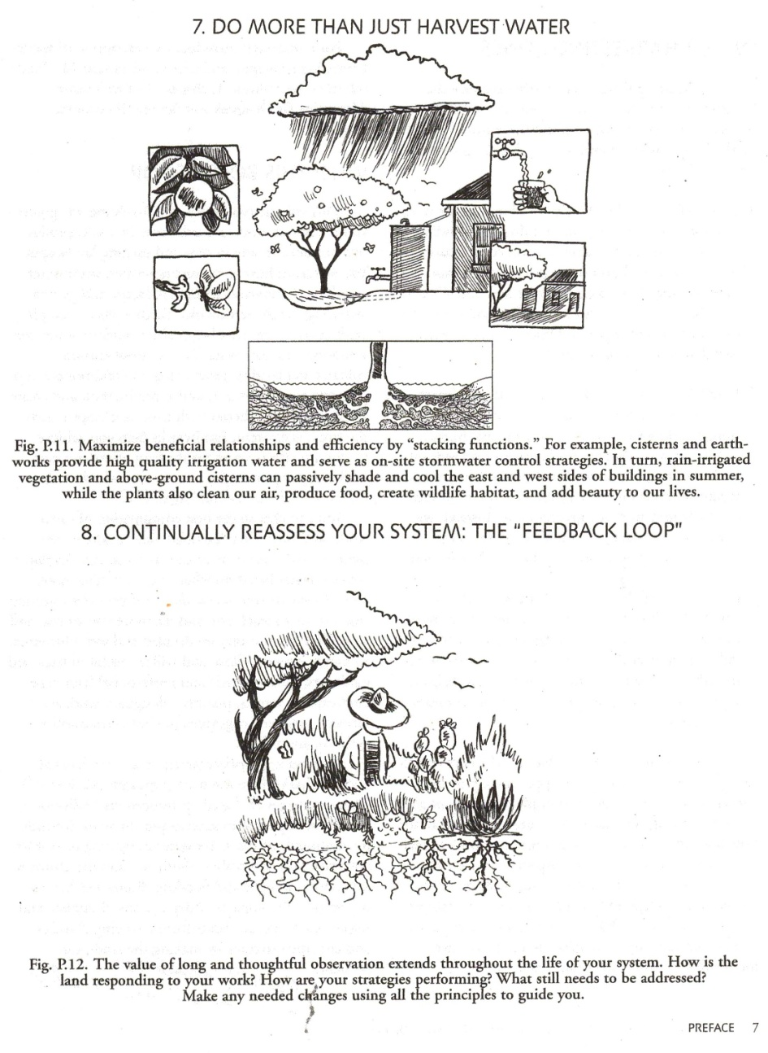
Notes:
Stacking functions & Continued observation and re-assessment

Slide 34
Three Oaks Rain Garden
Notes:
Standing water on heavy clay soil

Slide 35
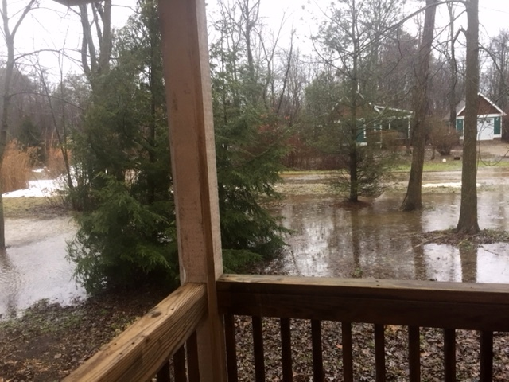
Notes:
After heavy rains and snow melt

Slide 36
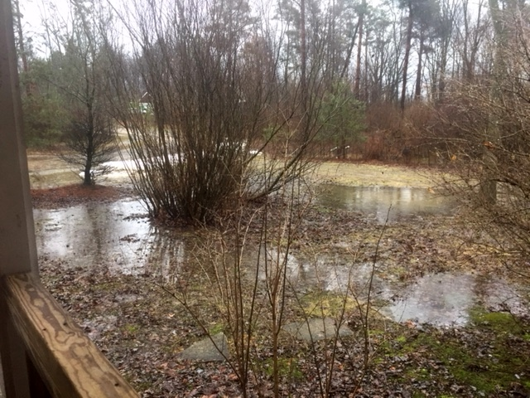

Slide 37
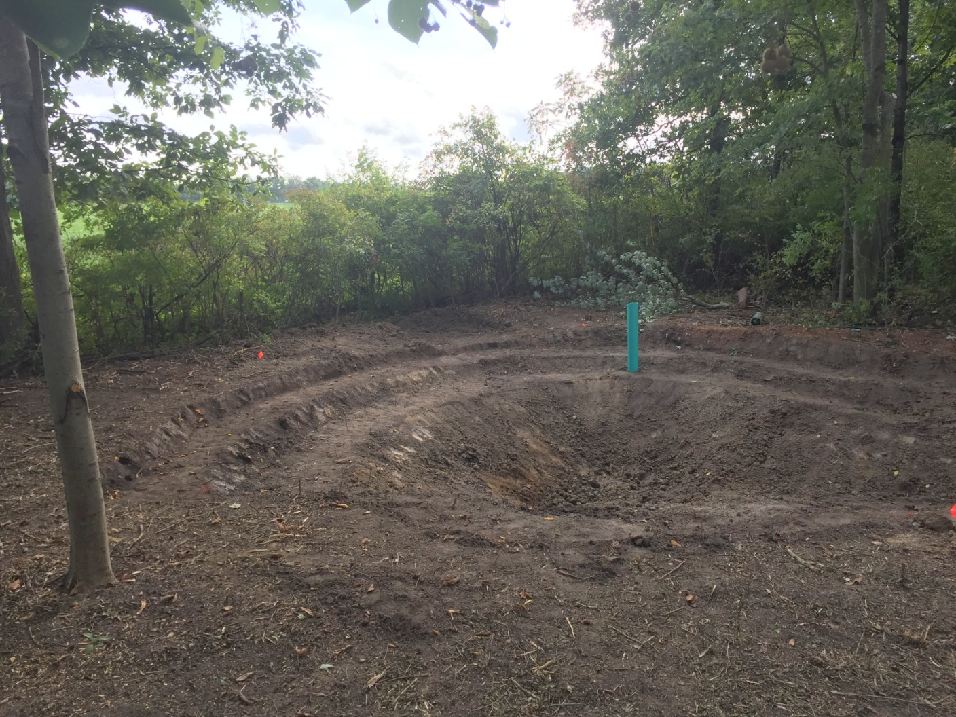
Notes:
Excavating the pond with terraces for planting, and an overflow

Slide 38
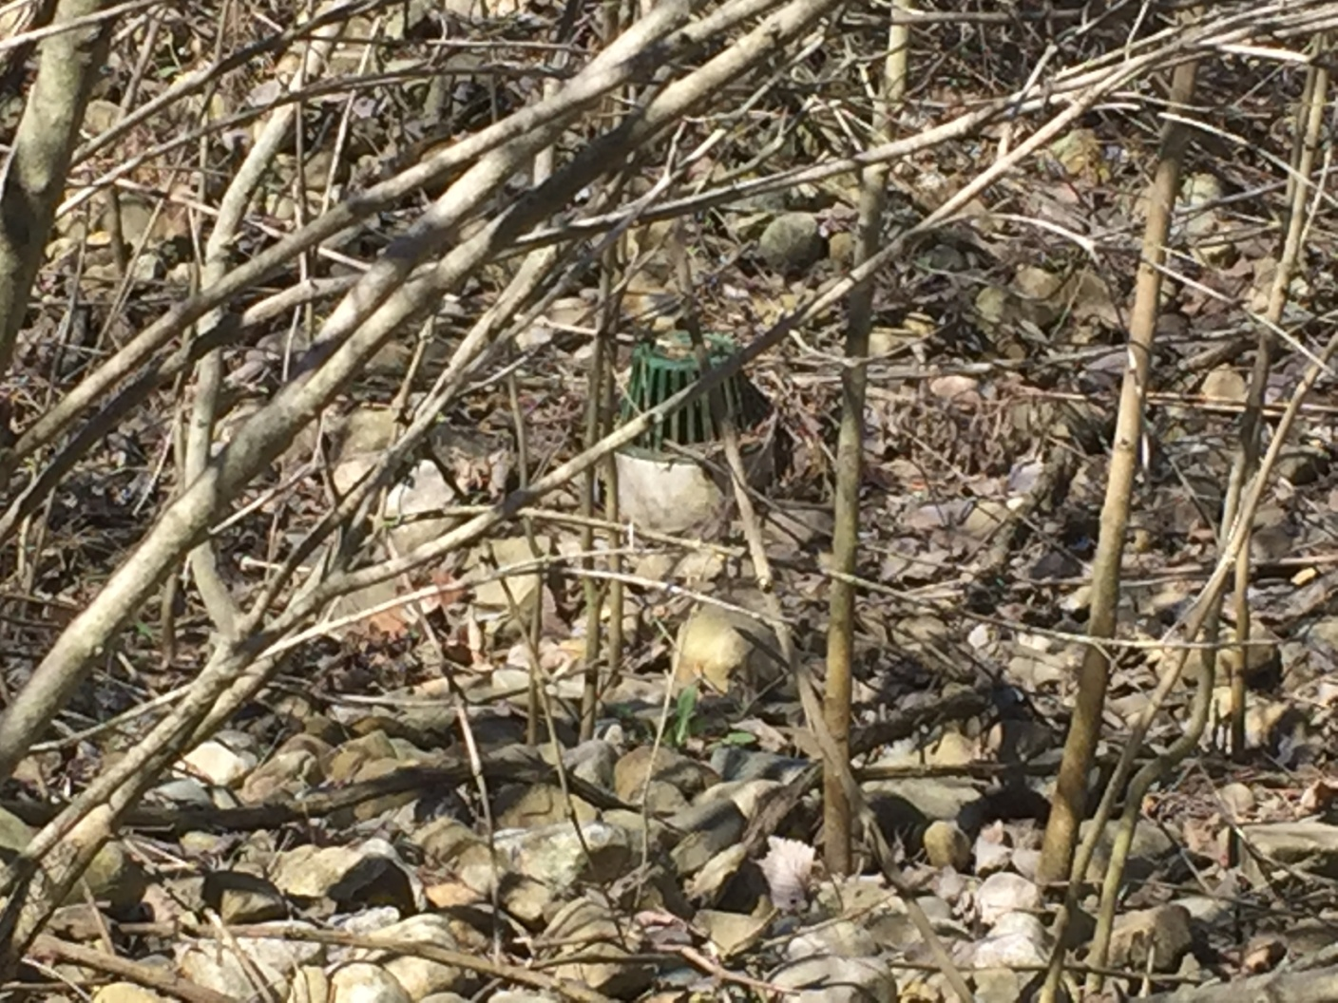
Notes:
Cobble rain basin with overflow and strainer cap

Slide 39
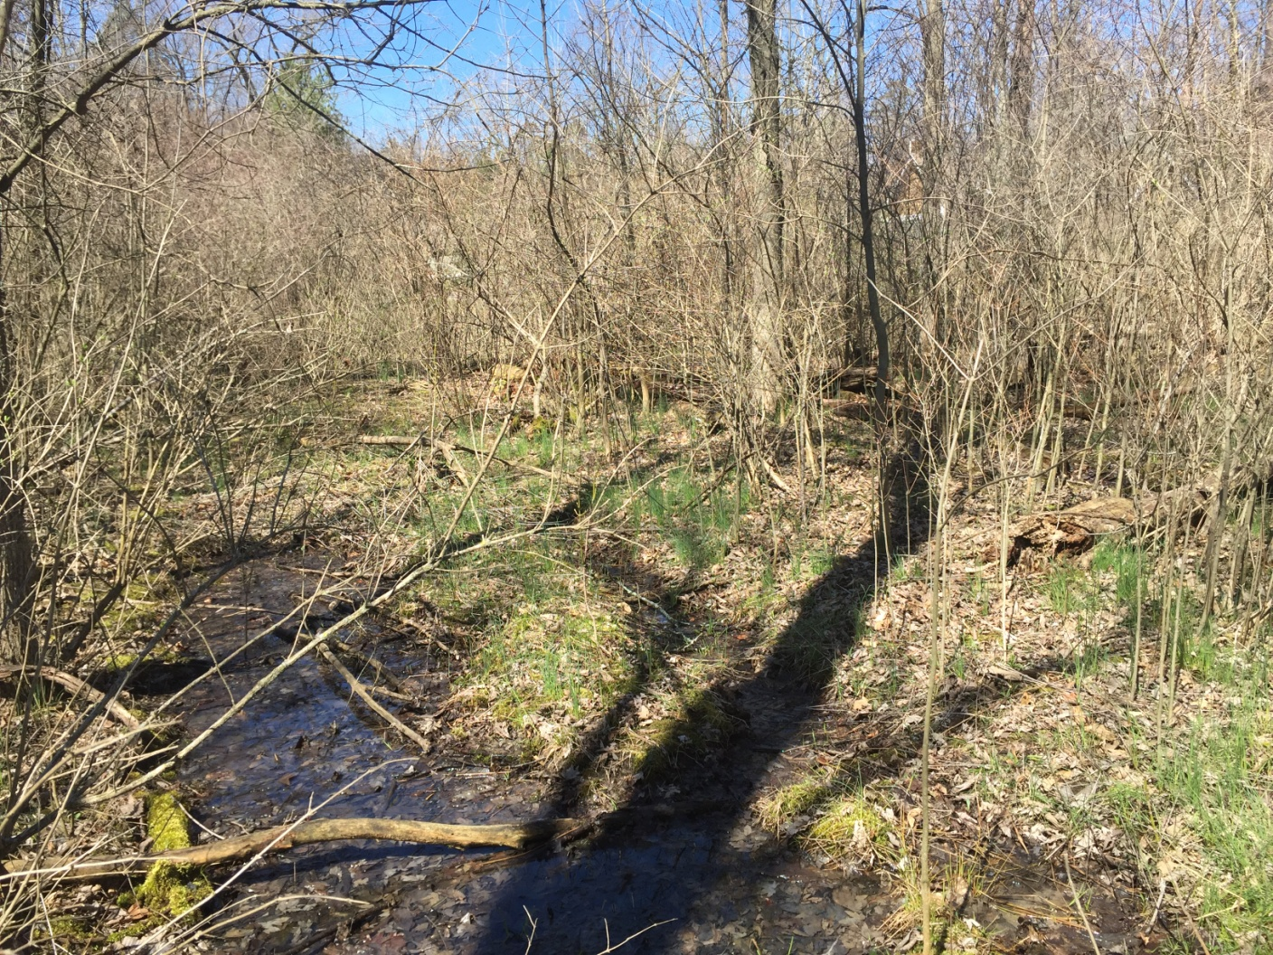
Notes:
Water way and overflow

Slide 40
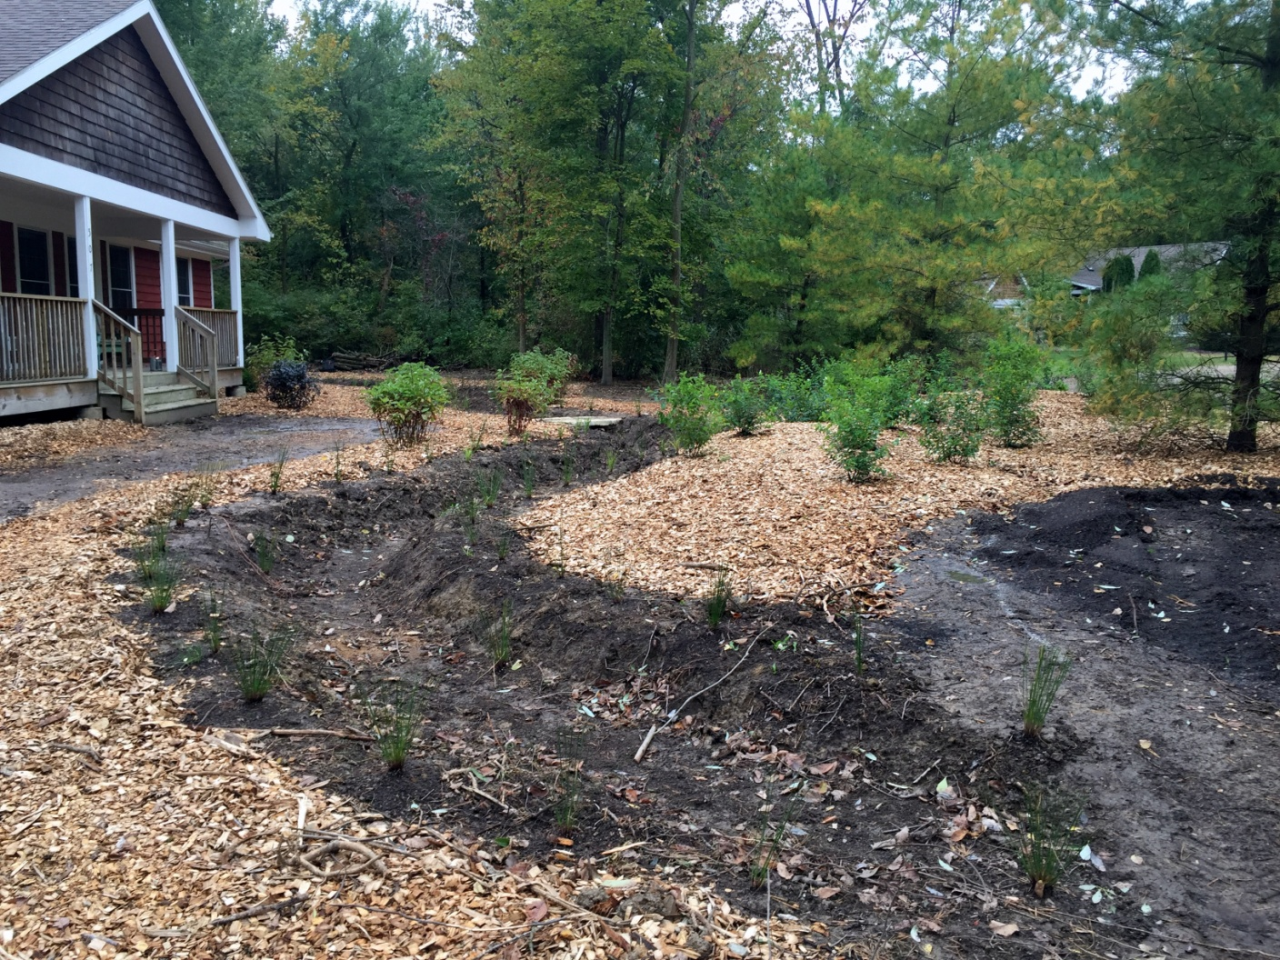
Notes:
Planted edge as a barrier

Slide 41
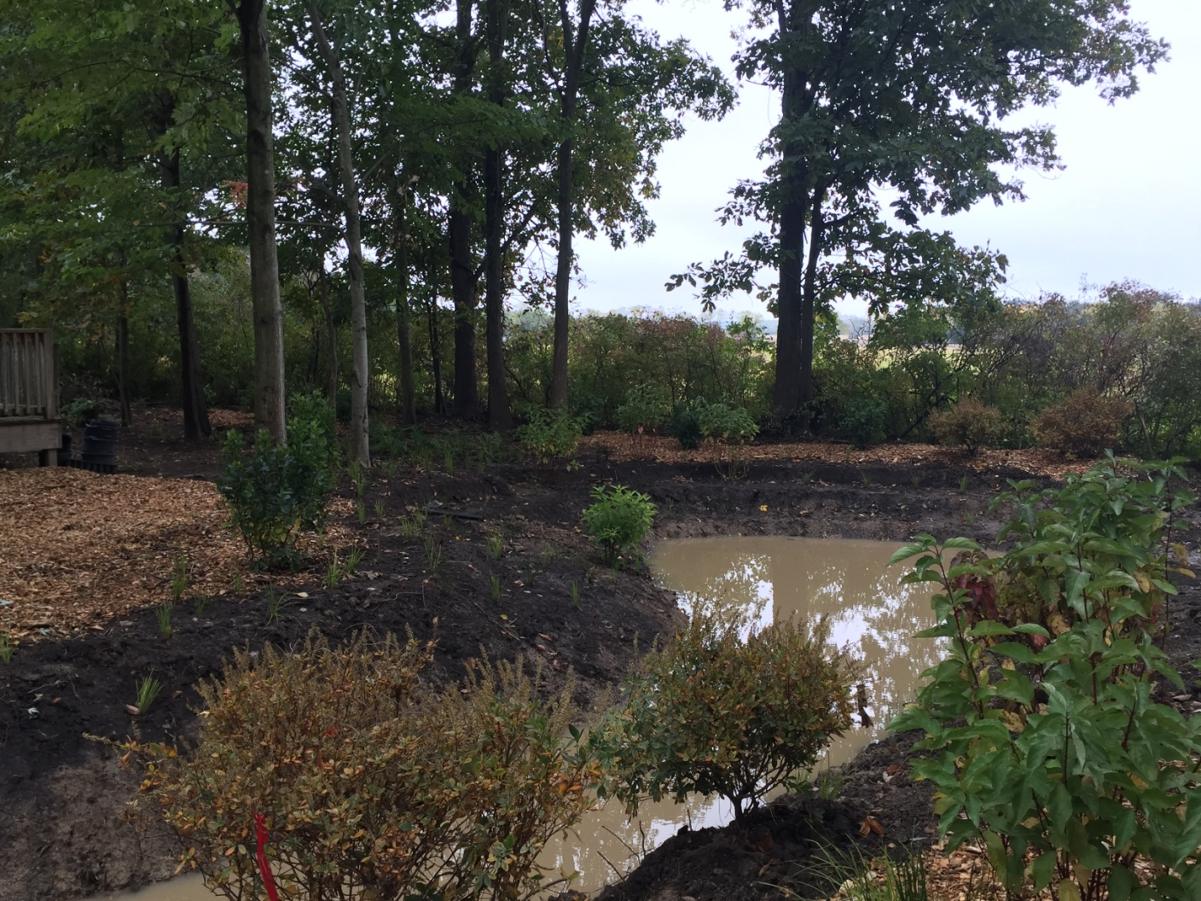
Notes:
I designed the planting plan for this rain garden with regional native plants to attract wildlife

Slide 42
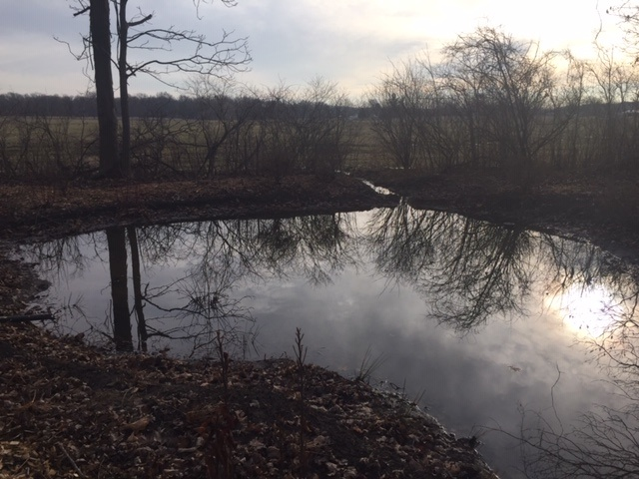
Notes:
You can see the secondary overflow at work

Slide 43
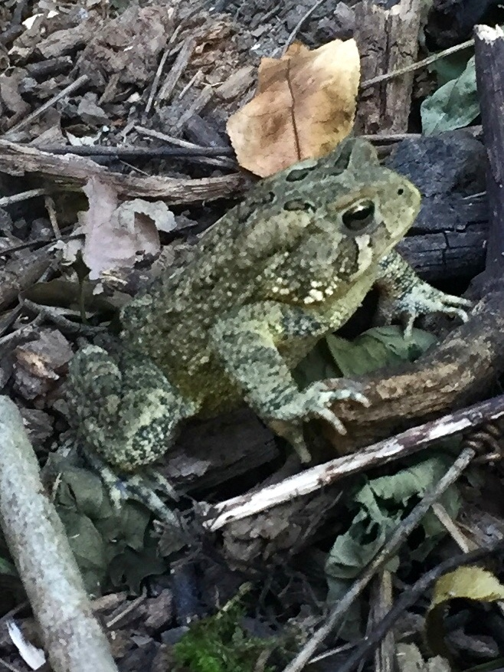

Slide 44
Planting a rain garden
Notes:
This is the number one resource you need as a planting guide (and Google too!)

Slide 45
Soil Matters
Notes:
Most Bay Area soils are heavy clay and rocky

Slide 46
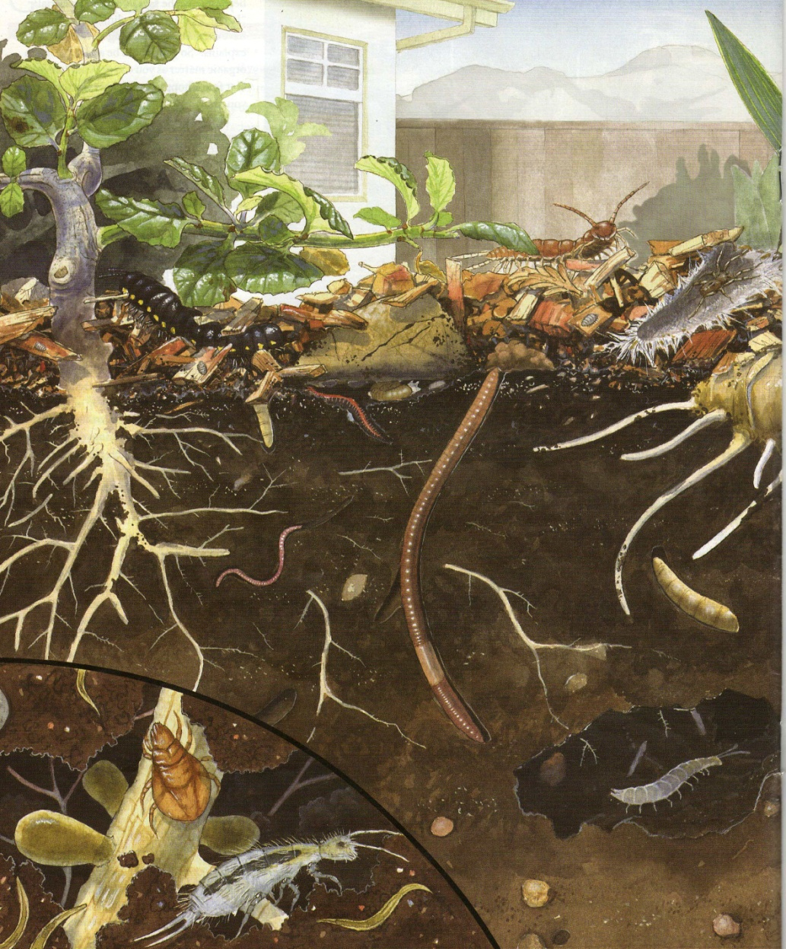
Illustration by Amadeo Bachar
Notes:
Micro-organisms are like little bulldozers, they break down leaf litter and aerate the soil

Slide 47
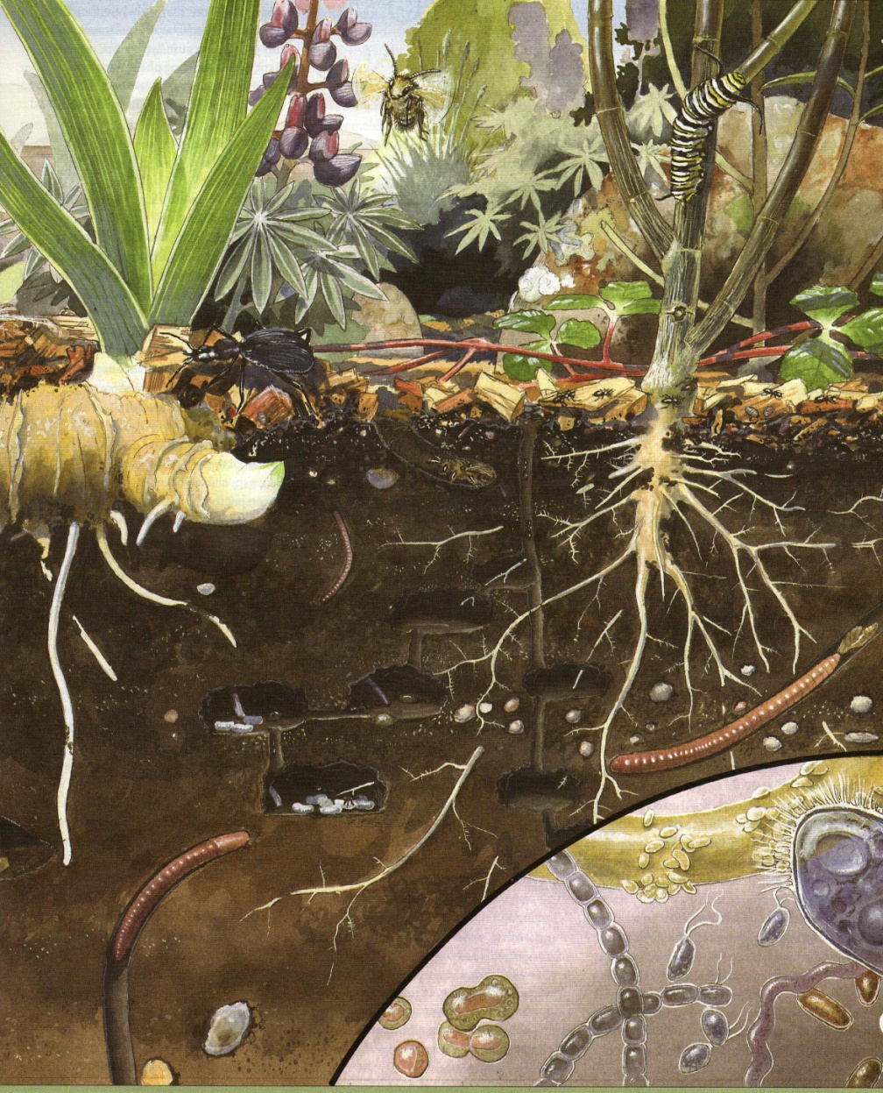
Notes:
Remember the standing water from the Three Oaks site?

Slide 48
Improving soil moister retention
Notes:
A very simple method that won’t break your back

Slide 49
Notes:
Most of us love nature, that’s one reason why we garden…

